Slide 1

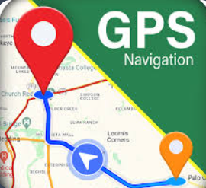
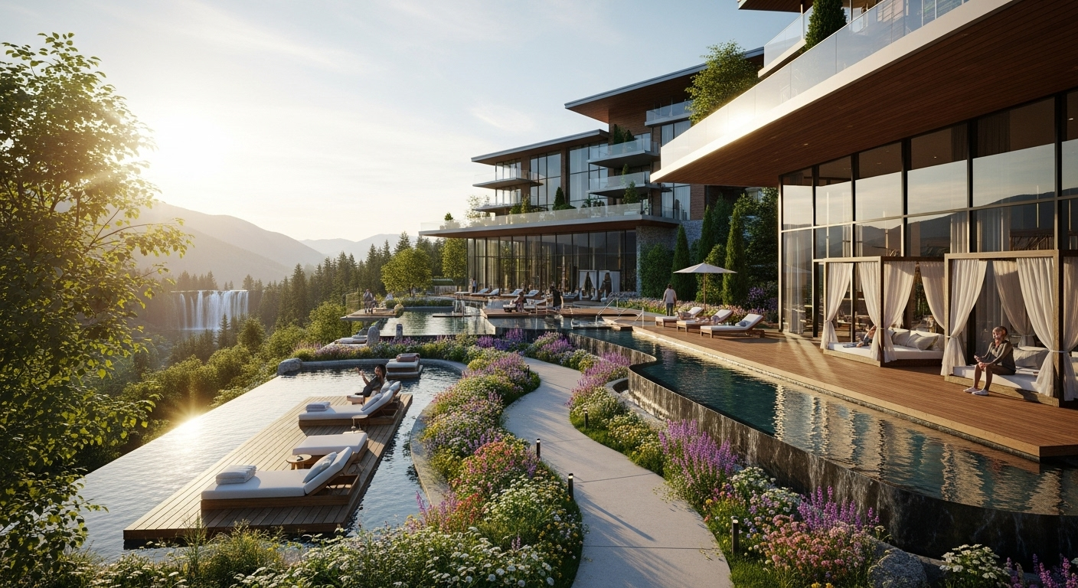
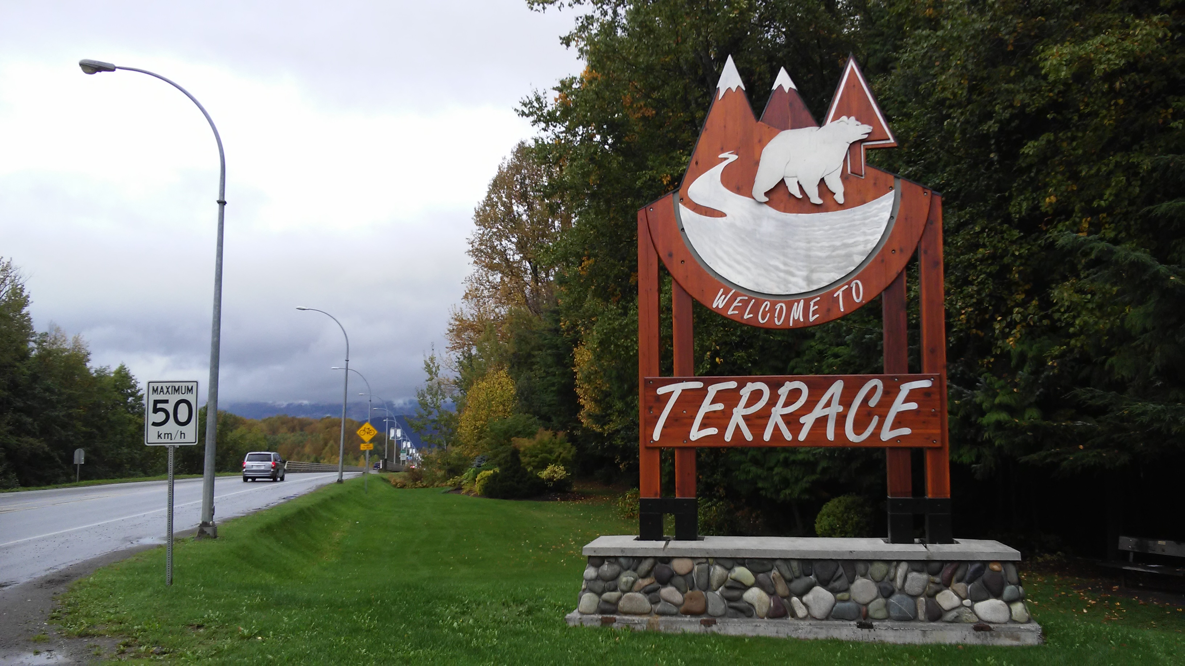
SESSION 1: Segmentation Lons Xtreme Touch
Geographic
Attractions
Location
Location: Terrace BC and surrounding areas (Kitimat, Thornhill and Prince Rupert). Accessible Downtown location, suitable for both residents and tourists.
Attraction: Potential to attract clients from nearby hotels, local events, and corporate partnerships.

Slide 2
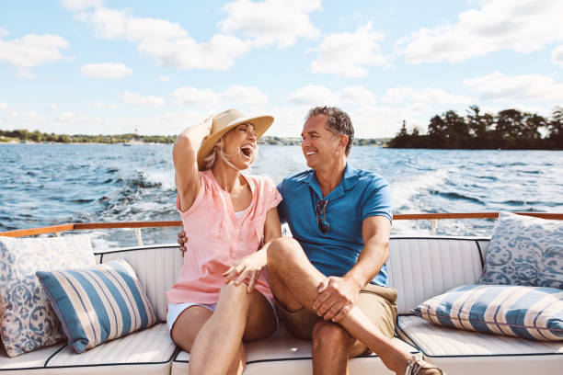

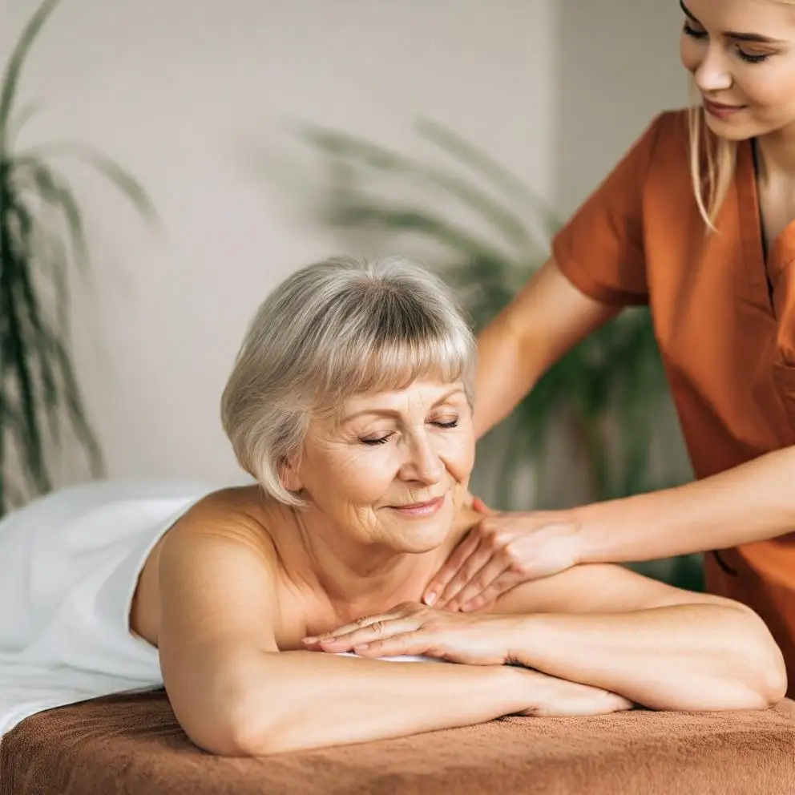
PSYCHOGRAPHIC
Lifestyle
Interest
Values
Lifestyle: people who value health, relaxation and self care
Self care, Massage therapy, Skin care, Wellness retreats and Premium pampering experience.
Quality service, Personal Wellness and Local community Support

Slide 3
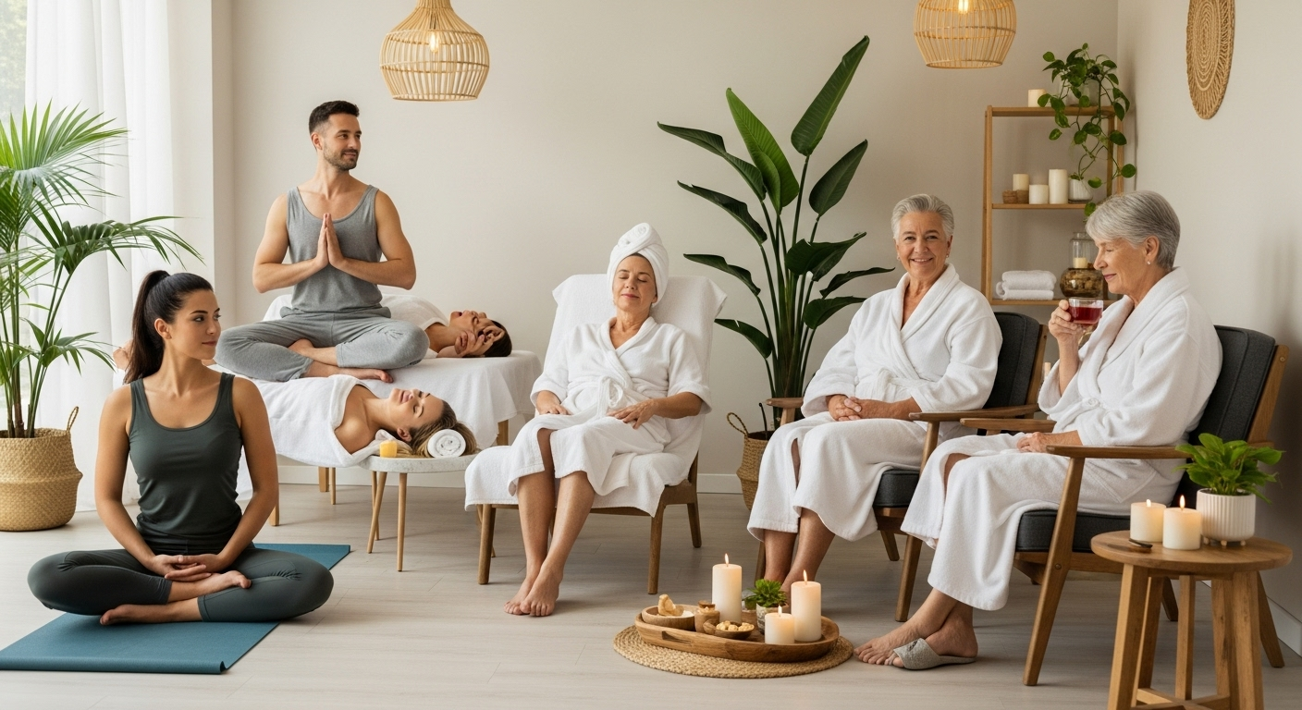
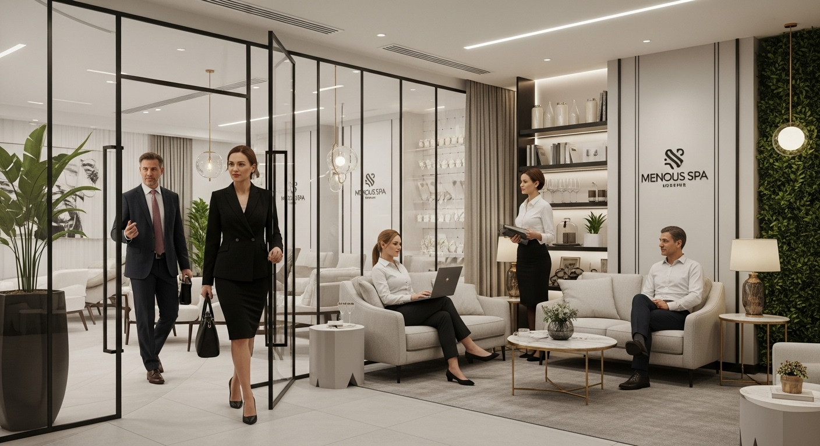
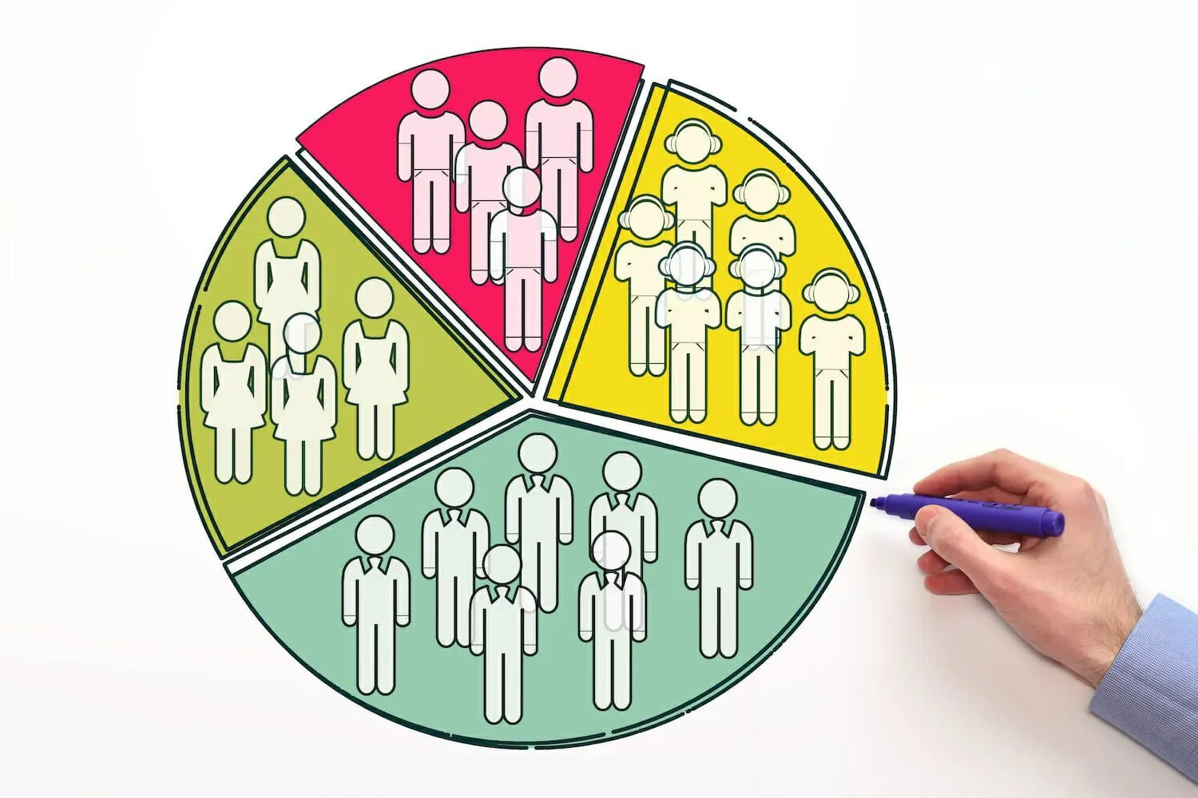


Demographic
Age: 18 – 65
Income Level
We provide service for adults from 18-65
Middle to upper Middle class who can afford spa and wellness Services.
Occupation
Genders
Working professional, Parents and Wellness-Conscious individuals
Ous services are suitable for all Gender

Slide 4
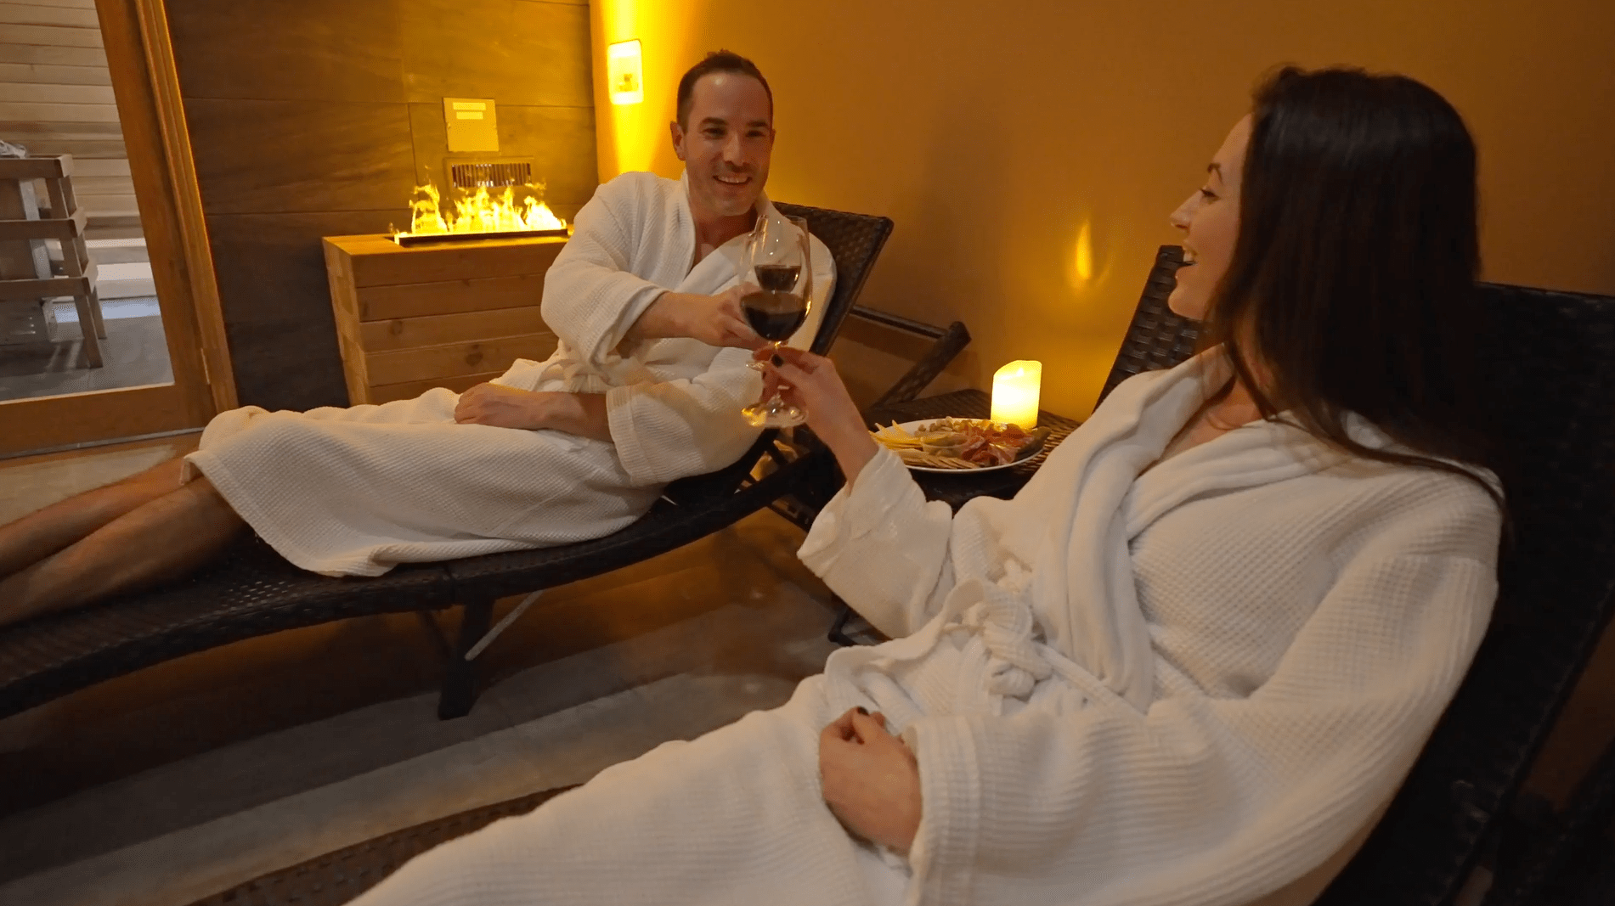

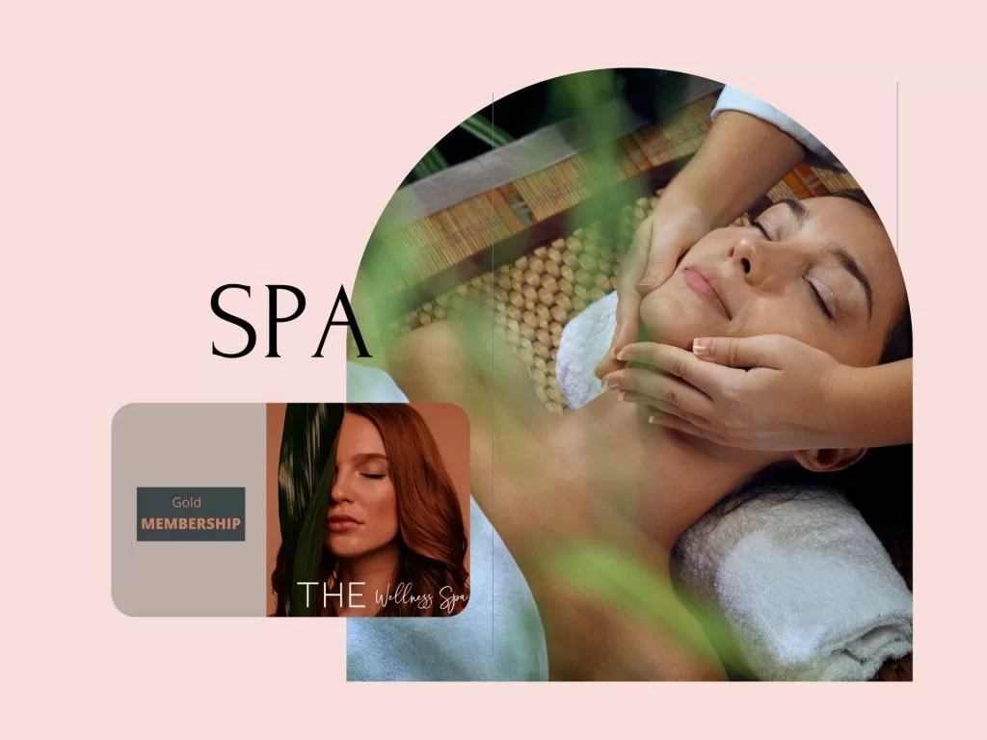
Behavioral
Occasions
Patronage
Loyalty
Regular Self-care Routines, Stress relief, Celebrations and gift experiences.
Mix of First-time spa goers and Loyal , repeat Customers
High potential for loyalty through personalized treatments and membership programs

Slide 5
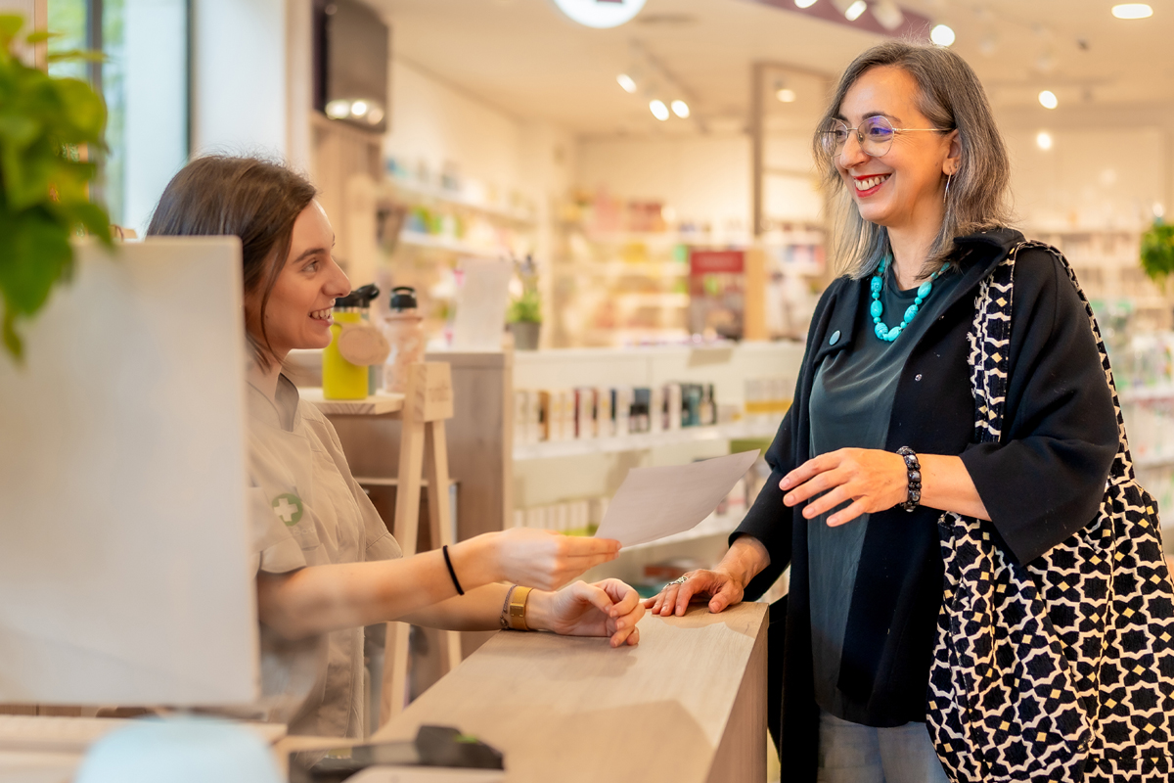
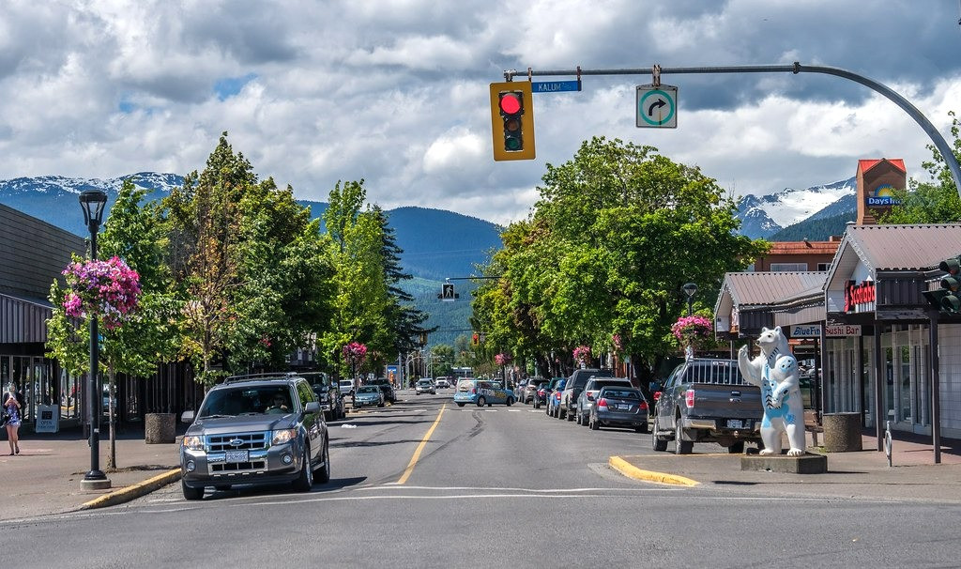
Section 2: Marketing Plan
Lons Xtreme Touch
Product
Place
The spa offers massages, facials, body treatments, aromatherapy, and wellness packages designed to relax and rejuvenate. We also provide skincare products, essential oils, and wellness gift sets for continued self-care at home.
Our spa is located in Terrace, BC, offering a serene and modern environment designed for comfort and relaxation.
The space features natural light, calming décor, and private treatment rooms, making it easily accessible to both locals and visitors.

Slide 6



Price
Promotion
Online Promotion
We’ll use Facebook, Instagram, and TikTok to share relaxing videos, countdowns, and behind-the-scenes clips highlighting our spa experience.
Community outreach
Our pricing reflects the quality and value of our premium wellness experience. A full-body massage costs CAD 140 for 60 minutes, while a pedicure and manicure session is CAD 90 per hour.
Other express treatments, such as mini facials or relaxation therapies, are available for 30 to 40 minutes at more affordable rates, ensuring options for every budget and schedule.
We’ll distribute flyers locally and partner with wellness-focused organizations to attract health-conscious clients.

